Slide 1
Factors Affecting Valence of Unexpected Events
Molly Quinn
Mark Keane
University College Dublin
Notes:
Intro: Final Year PhD student

Slide 2
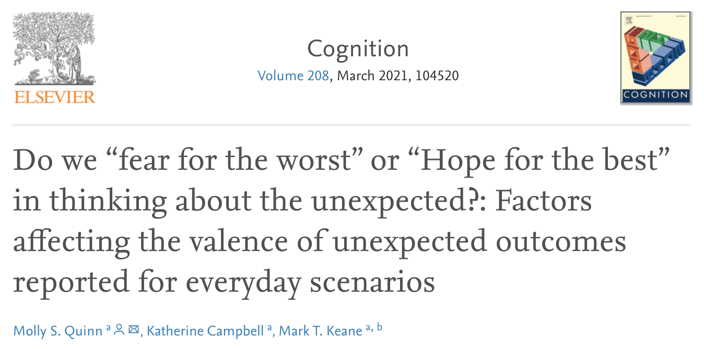

https://doi.org/10.1016/j.cognition.2020.104520
Winner of European Society of Cognitive Psychology
Early Career Publication for PhDs
Notes:
About how features of current events affect our predictions of future events
Winner of ESCoP early career publication award
There is actually quite a lot of data and measures in these studies,
In the interest of time, I will be talking only about valence and two of three studies

Slide 3
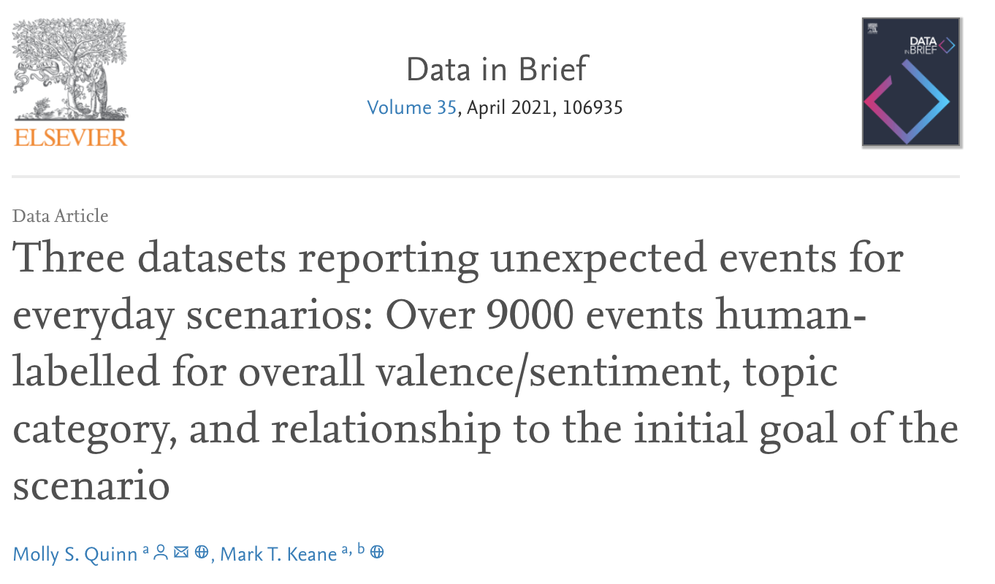
http://dx.doi.org/10.17632/kkt999sn7b.1
Notes:
Also released the data – human labelled on things like sentiment
and code for all three studies in the paper,
With data in brief
My goal is to interest you to click on those links

Slide 4
Outline
Predicting Unexpected Events
Experiments on the Valence of Unexpected Events
Conclusions & Future Work
Notes:
First, I’ll explain the task of predicting unexpected events
Then, I’ll explain why valence is important to the unexpected
End on some conclusions and current work

Slide 5
Predicting Unexpected Events
In a foreign city and worried about missing a flight?
Q: What unexpected things could occur?
Traffic is really bad here…
Buses are unsafe…
Taxi drivers are unreliable…
Police outriders escort me to the airport…

Slide 6
Predicting Unexpected Events
In a foreign city and worried about missing a flight?
Q: What unexpected things could occur?
Traffic is really bad here…
Buses are unsafe…
Taxi drivers are unreliable…
Police outriders ferry me to the airport…
Notes:
Many things we think of happening are negative, but can be positive

Slide 7
What is “Unexpected”?
Subjective probability?
What things do people mutate in the unexpected?
What is the valence of the event?
Notes:
What is the unexpected?
What do Ss interpret “unexpected” as….
My group working on explainable AI
It is important to see what people think of as unexpected and needing to be explained,
But also what people predict as unexpected may not be what is actually unexpected in the end
so potentially undo biases
The studies all used similar tasks to get at these questions
Show example, then talk about the studies

Slide 8
Instructions
“Something unexpected occurred…” (UNEXP)
“Something good and unexpected occurred…” (UNEXP-GOOD)
“Something bad and unexpected occurred…” (UNEXP-BAD)
“What do you think happened?”
Notes:
If I ask you to think of an unexpected event that could occur next, you may think of an unexpected good event or an unexpected bad event.
Pos and neg appear important in our data, but Leake and Schank do not account for that.

Slide 9
Material Scenarios
Sentence Type | Scenario
Goal | Louise wants to shop at an expensive clothes store.
Intermediate Event | She is wearing her favourite dress and matching shoes.
Plan Step | Louise draws money from the ATM.
 | Something unexpected occurred. What do you think happened?
Notes:
SHOW LOUISE PLOTS

Slide 10
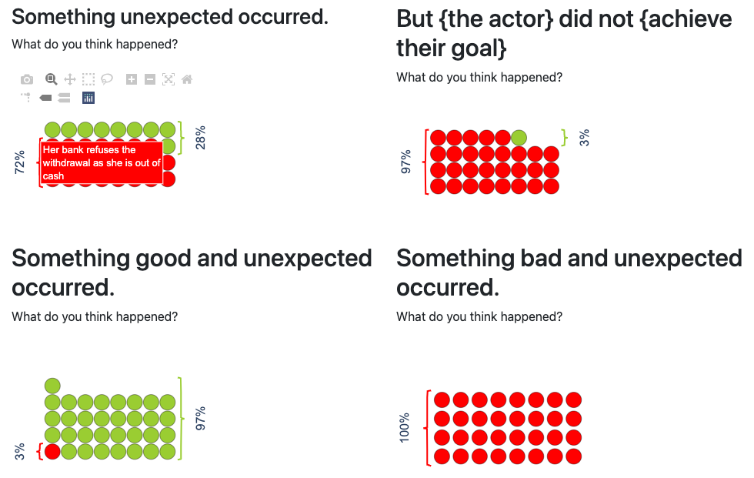
Notes:
People mostly report bad things.
But can give good things
Can give bad things
But for the most part, give negative, when not instructed otherwise.

Slide 11
Some Example Responses
“She saw the account balance as she withdrew money and realized she didn't have enough to justify the shopping trip”
“She is robbed at the ATM”
“She had more money that she realised so could buy something expensive.”
Notes:
While there was an average of 10 answer categories for each scenario,
The top 3 categories covered an average of 60% of the responses.
But, when asked for the good unexpected, people could give positive events.
So, why do people give mostly negative events?

Slide 12
Some Example Responses
“She saw the account balance as she withdrew money and realized she didn't have enough to justify the shopping trip” (ls_neg_ans1)
“She is robbed at the ATM” (ls_neg_ans3)
“She had more money that she realised so could buy something expensive.” (ls_pos_ans2)
Notes:
While there was an average of 10 answer categories for each scenario,
The top 3 categories covered an average of 60% of the responses.
But, when asked for the good unexpected, people could give positive events.
So, why do people give mostly negative events?

Slide 13
Study 1 - Method
20 Materials: Louise, Bob…
4 Conditions
Unexpected, Unexpected-Bad, Unexpected-Good, Goal-Fail
2 Sentence Order Conditions
Further action sentence or intermediate event sentence last
2 Comprehension Question Conditions
Comprehension question about the goal-sentence/intermediate-event
N = 127 generating 2,540 unexpected-event responses

Slide 14
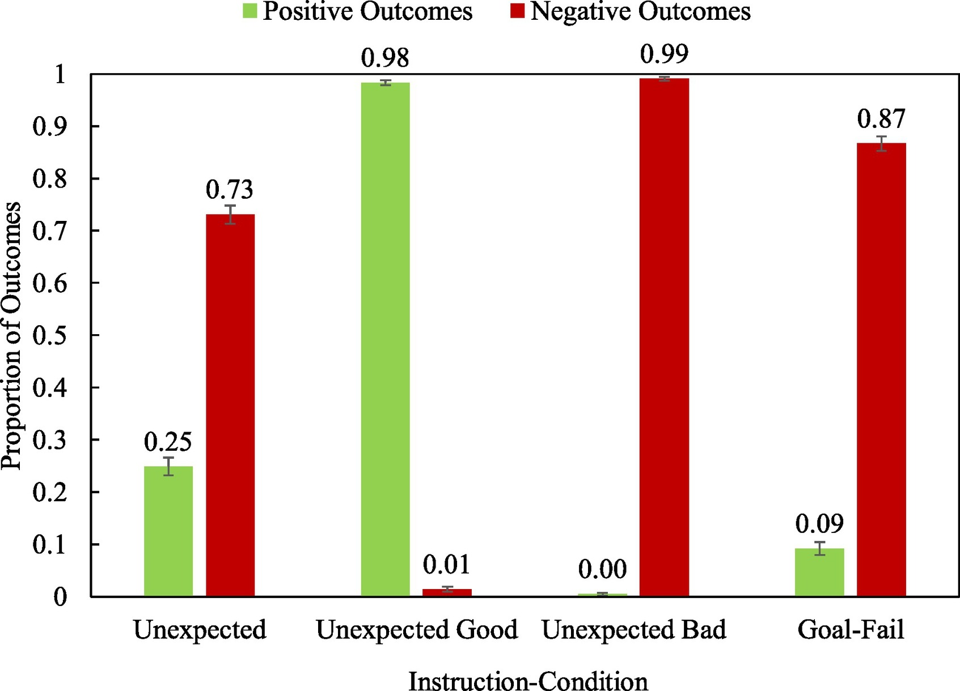

Slide 15
What leads to positive vs. negative unexpected events?
Negativity Bias
Positivity Bias
Valence Countering – current contribution
Notes:
Is it a bias toward negativity?
Is it the lesser-seen bias toward positivity (things will work out ok)?
Or is it that when asked for an unexpected event, people flip the valence?
When things are going well, it’s unexpected that they’ll end up poorly.
When things are going poorly, it’s unexpected that they’ll end up well.

Slide 16
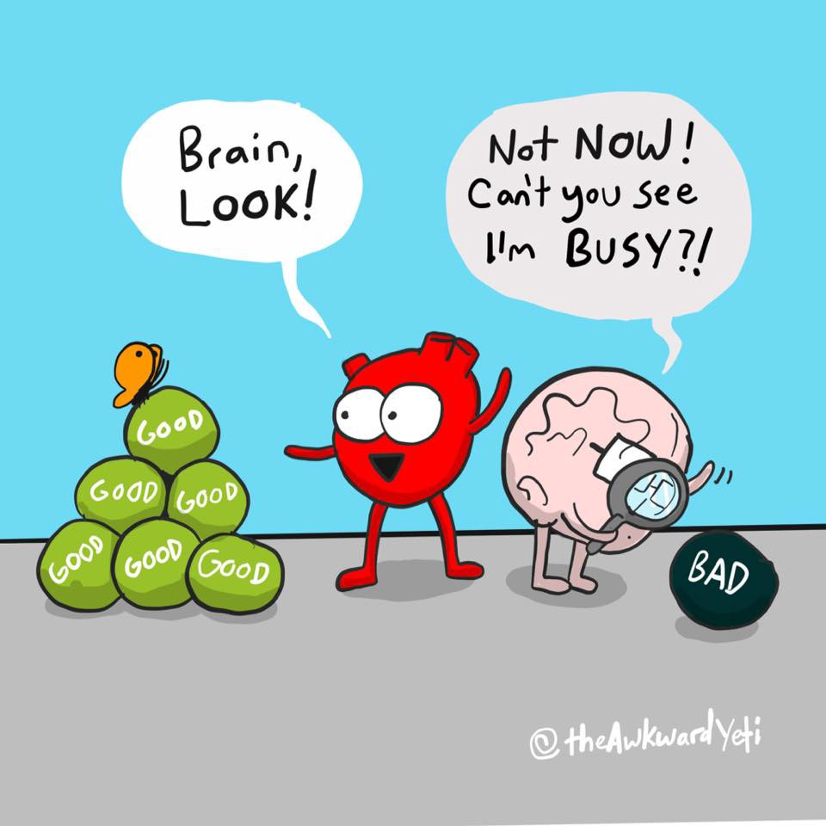
Negativity Bias
“Bad is Stronger than Good” (Baumeister et al., 2001)
“losses loom larger than gains” (Kahneman & Tversky, 1979)
“﻿greater psychological impact of negative events than equivalent positive events”
(Rozin & Royzman, 2001)
Causal reasoning for unexpected and negative events.
(Taylor, 1991)
Notes:
Losses Loom Larger
It might make sense then, that we see more negative responses,
Because we have more activation for negative events in general.
“Specifically, diverse literatures in psychology provide evidence that, other things being equal, negative events appear to elicit more physiological, affective, cognitive, and behavioral activity and prompt more cognitive analysis than neutral or positive events.”

Slide 17
Positivity Bias
Positive events are more common
(Peeters, 1971)
Belief that things will generally work out well
(Rozin & Royzman, 2001)
More positive affect in memories
(Singer, Rexhaj, & Baddeley, 2007).
Overconfidence in future positive events
(Pulford & Colman, 1996)
Credit KC Green
Notes:
Evidence that, psychologically, positive valence is an important aspect of events in our lives.

Slide 18
Another Example:
Sentence Type | Scenario
Goal | Bob wants to quit his job because he is not credited for his hard work.
Intermediate Event | On arriving at the office, he turns on his computer and starts working as usual.
Plan Step | At coffee-time, Bob goes to talk to his boss about his job.
 | Something unexpected occurred. What do you think happened?
Notes:
SHOW BOB PLOTS

Slide 19
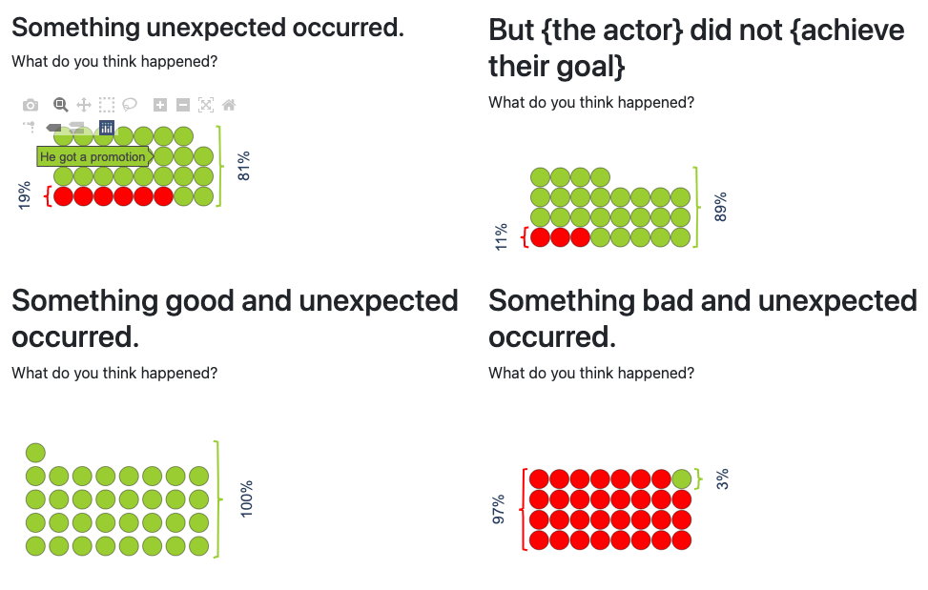

Slide 20
Some Example Responses
“The boss told him he was doing a great job and apologized for not giving him more credit.” (bj_pos_ans3)
“His boss admits he is not been treated fairly and gives him a raise.” (bj_pos_ans2)
“His boss fires him.” (bj_neg_ans1)
Notes:
81% in top 3
And when asked for bad events, they were able to provide bad events…

Slide 21



Current Hypothesis: Valence Countering
Unexpected Event
(Response)
Material
The “unexpected” is the counter of the valence of the given events.
Notes:
One reason we see negativity is valence of material is not carefully controlled for….

Slide 22
Current Hypothesis: Valence Countering
Unexpected Event
(Response)
Material
The “unexpected” is the counter of the valence of the given events.
Notes:
One reason we see negativity is valence of material is not carefully controlled for….

Slide 23
Louise wants to go shopping and stops by the ATM to get some money.
Unexpectedly, “She was robbed at the ATM.”

Slide 24
Bob wants to quit his job because he is not credited for his hard work.
Unexpectedly, “The boss told him he was doing a great job and apologized for not giving him more credit.”

Slide 25
Study 3 – Method
As before,
20 materials (10 scenarios with positive/negative variants)
2 Valence Conditions for the Same Scenario
Positively or Negatively Valenced Plan Step
1,018 Unexpected Events from 102 Participants
(2 missing responses)

Slide 26
Study 3 – Material Example
Sentence Type |  | Scenario
Goal |  | Louise wants to shop at an expensive clothes store.
Valenced Plan Step | POS: | The previous week, she received a pay rise because she won a big account for her company.
 | NEG: | The previous week, she received a pay cut because she lost a big account for her company.
Plan Step |  | Louise draws money from the ATM.
 |  | Something unexpected occurred. What do you think happened?
Notes:
* Positive Version result is exact replica of Experiment 1 un-valenced condition.

Slide 27
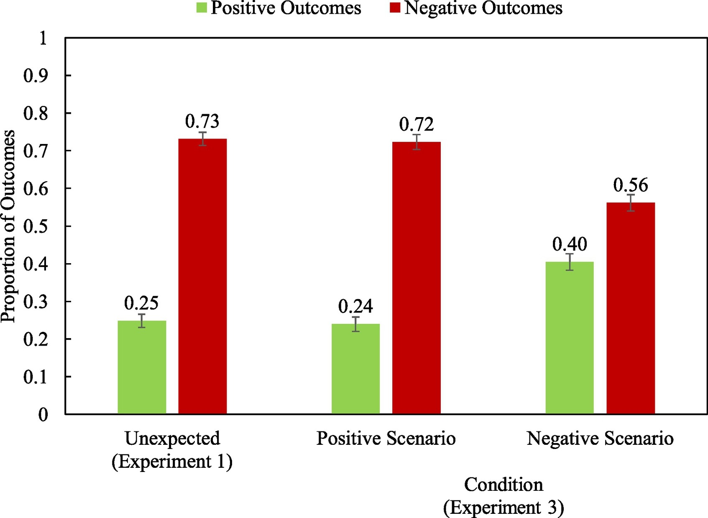

Slide 28
Conclusions
There does appear to be a negativity bias.
regardless of material valence.
However, there also appears to be a slight countering effect.
Negative materials get more positive answers…
Applications: CBT, XAI, etc…
Notes:
Why are we interested in this?

Slide 29
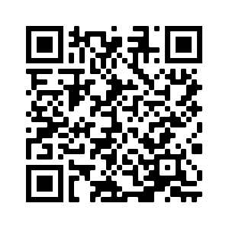
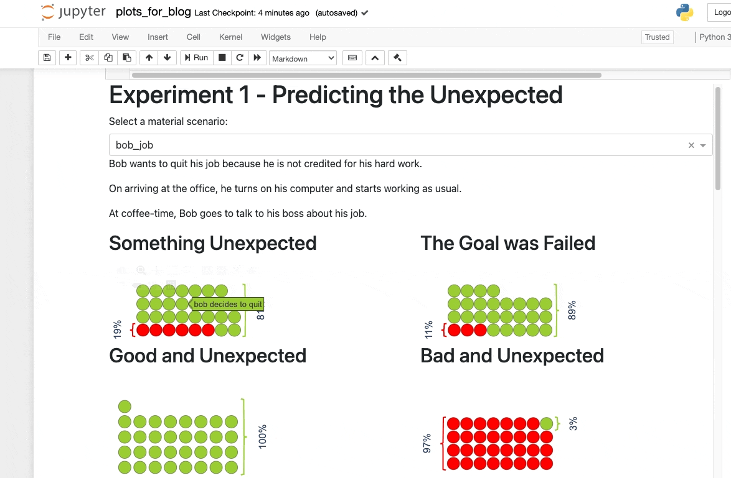


The Papers, The Data, The Plots
https://github.com/MollySQuinn/interactive_unexpected_events
MollySQuinn
molly.quinn@ucdconnect.ie

Slide 30
References
Taylor, S. E. (1991). Asymetrical effects of positive and negative events: The mobilization-minimization hypothesis. Psychological Bulletin, 110(1), 67–85.
Baumeister, R. F., Bratslavsky, E., Finkenauer, C., & Vohs, K. D. (2001). Bad is stronger than good. Review of General Psychology, 5(4), 323–370. https://doi.org/10.1037//1089-2680.5.4.323
Rozin
Peeters, G. (1971). The positive‐negative asymmetry: On cognitive consistency and positivity bias. European Journal of Social Psychology, 1(4), 455–474.
Pulford, B. D., & Colman, A. M. (1996). Overconfidence, base rates and outcome positivity/negativity of predicted events. British Journal of Psychology, 87(3), 431–445.
Singer, J., Rexhaj, B., & Baddeley, J. (2007). Older, wiser, and happier? Comparing older adults’ and college students’ self-defining memories. Memory, 15(8), 886-898

Slide 31
Study 2 – Method
20 Materials: Louise, Bob…
6 Conditions:
Unexpected, Unexpected-Bizarre,
Unexpected-Bad, Unexpected-Bad-Bizarre,
Unexpected-Good, Unexpected-Good-Bizarre
2 Sentence Order Conditions
Further action sentence or intermediate event sentence last
2 Comprehension Question Conditions
Comprehension question about the goal-sentence/intermediate-event
N = 257 generating 5,140 unexpected-event responses

Slide 32
